Slide 1
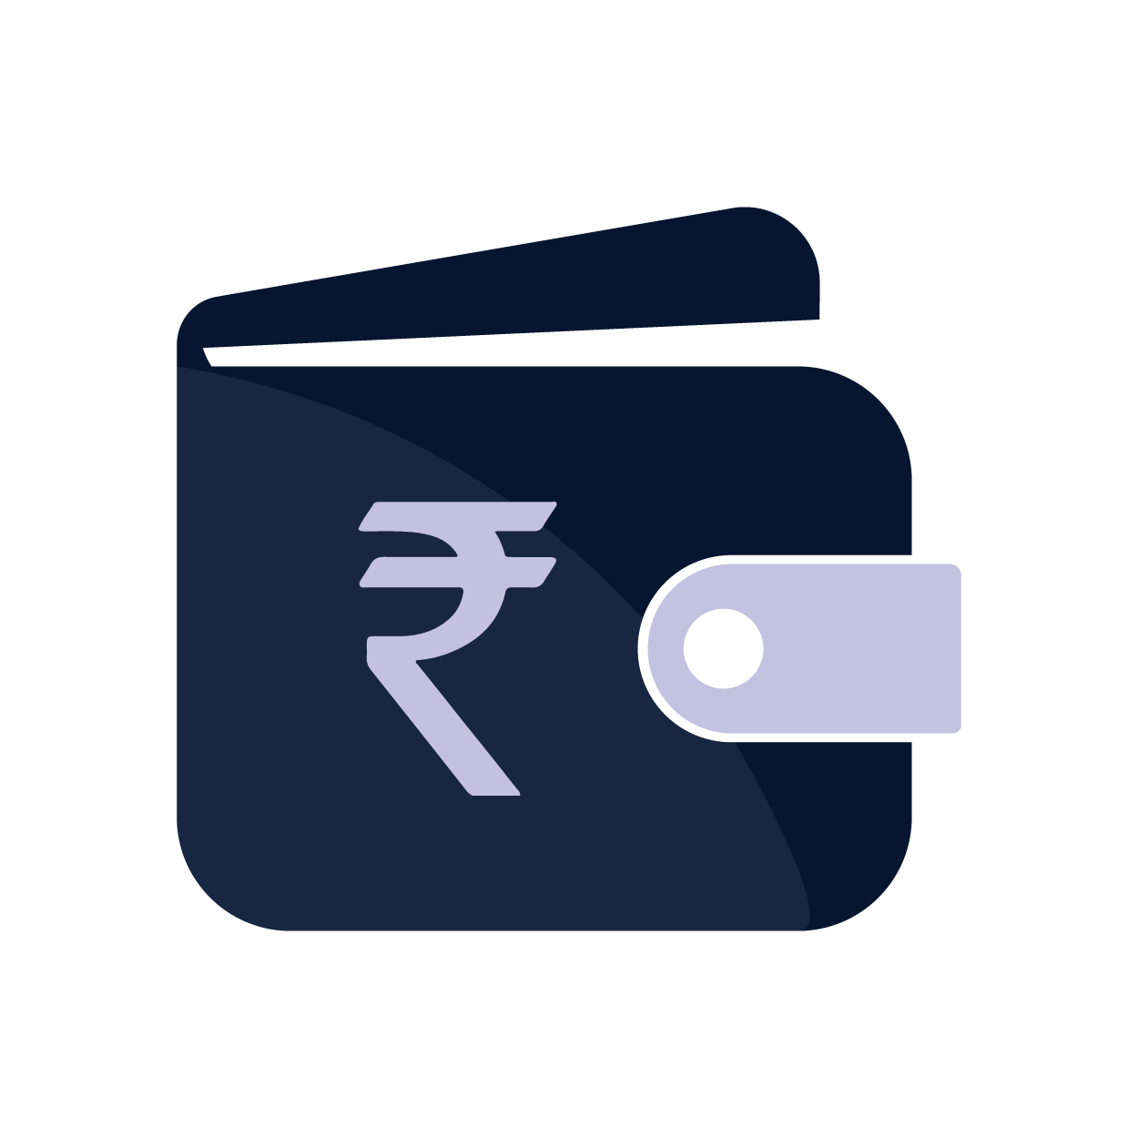

WALLET ACE YOUR PERSONAL FINANCE MANAGER

Slide 2
Sr | Name | Enrolment Number
1 | Jay Vekariya | 2102030400379
2 | Yash Ukani | 2102030400387
3 | Arpit Vasoya | 2102030400377
4 | Pruthu Vanara | 2102030400374
5 | Jenil Vekariya | 2102030400380
Guide: Parth Wadhva

Slide 3

As per a survey in 2022,more than 1,000 kids of age group 14 to 24-year,found that 57 percent said saving and Money Management was “very important” for them.

Slide 4

Introduction to Wallet Ace
A SIMPLE AND EASY WEBSITE TO TRACK ALL YOUR EXPENSES AND MAINTAIN PROPER RECORD OF IT.

Slide 5
WHY WALLET ACE?
Wallet Ace offers a holistic financial dashboard that provides a overall view of your finances & Expenses.
You can Track your Expenses & categorization simplify financial insights..
You can set a Personalized budgeting keeps you on track.
Wallet Ace is accessible on your terms. Use our responsive website to manage your finances whenever and wherever you need.

Slide 6
Origins of our Problem
Not keeping any records of the Money spent

Slide 7
Existing Solutions
The current Money Management Models have certain drawbacks such as:
Not So User Friendly.
Difficult to Operate and Handle.
Requires Subscriptions for the Premium Features.
Multiple Ads and Pop-ups.

Slide 8
Features
Our website, Wallet Ace will allow its users to track their expenses on daily basis.
It will be useful in tracking all the spendings and managing a record for the users.
Our website will allow their users to set fixed Monetary Budget and receive alerts notifications when they are overspending .
Provides Detailed Monthly Analysis of the expenses & warns the users about their spendings.

Slide 9
Features
Easy to Access and manage the Monetary spendings.
Multi-factor Authentication with the Password and the providing the key specific to the email Id.
We can split the expenses among the friends and family members and send them the Monthly Expenses Transaction file to the members so that they can analyze and identify the transactions done by them.

Slide 10
Aims & Objectives

Slide 11
Our Aim with Our Project
To help user in managing and achieving their financial goals.
To provide financial planning which would develop a habit of keeping budget and managing their deus.
Our Main audience would be today’s new young generation as in to help them in their Financial Planning.
To help user in understanding their expenses.

Slide 12
How this will help in Viksit Bharat?
Financial inclusion: Viksit Bharat aims to empower people, and financial inclusion is a key aspect. Our app could potentially help individuals who are new to the formal financial system by Offering an easy to use Platform and Managing Shared Expenses.
Budgeting and Savings: Wallet Ace can help individuals and families in Viksit Bharat to budget effectively and save Money. By providing tools for expense tracking, budget planning, and setting financial goals, it can encourage responsible financial habits and savings.
Wallet Ace can offer educational resources and financial literacy programs to help people in Viksit Bharat understand basic financial concepts and make informed financial decisions.
It can provide tips, tutorials, and articles on topics such as budgeting, saving, investing, and debt management.

Slide 13
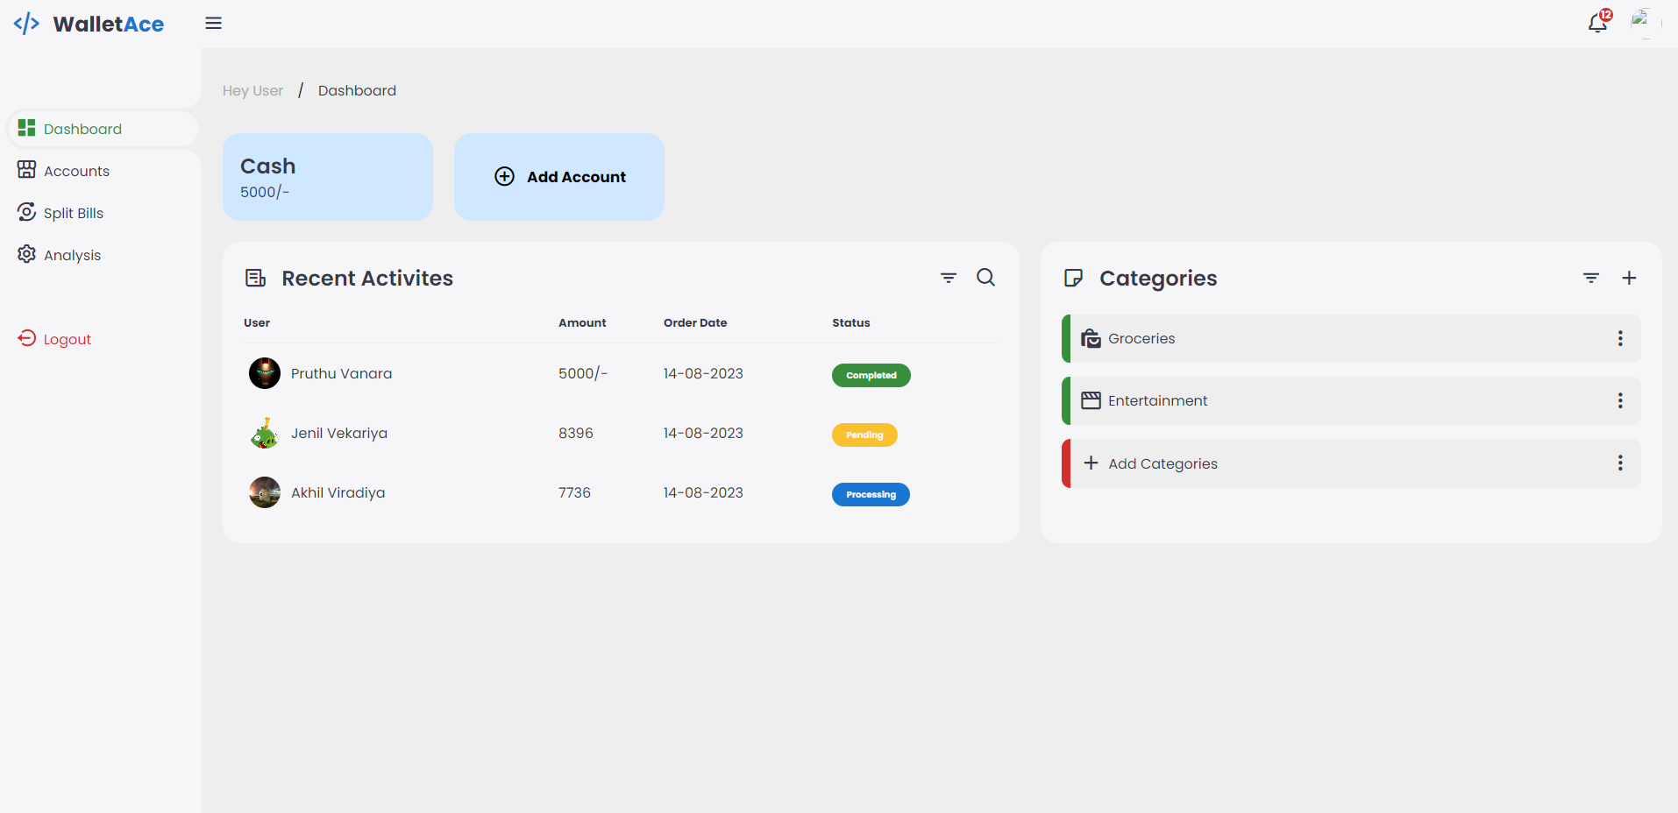
User Profile
Processing Work
Navigation Menu
Recent Transaction
Categories

Slide 14
Proposed Work
1. Registration and Onboarding:
Users start by registering for an account on Wallet Ace. They provide their username, email, and create a secure password.
Upon registration, you may optionally send a verification email to confirm their email address.
2. Dashboard Overview:
After logging in, users are presented with a dashboard overview of their financial data. This includes an overview of income, expenses, account balances.
3. Expense Tracking:
Users can enter and categorize their daily expenses, helping them track where their money is going.
The system can offer insights and visualizations to show spending patterns.
4. Budget Creation:
Users have the option to create monthly or yearly budgets.
They specify budget categories and spending limits, with the system providing real-time tracking against these budgets.

Slide 15
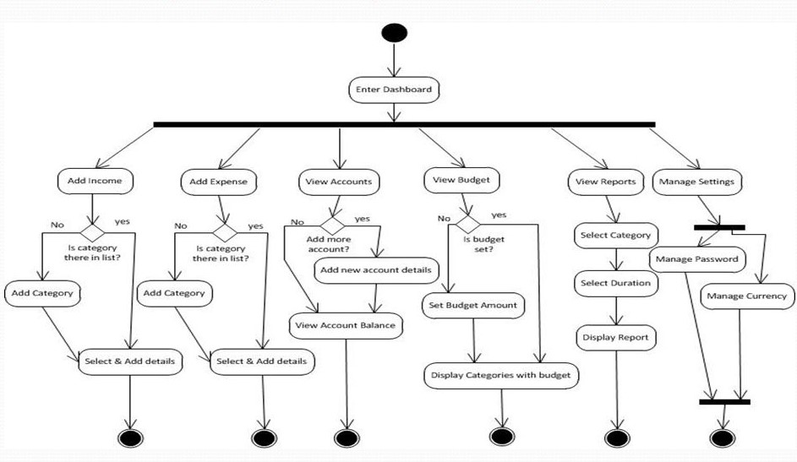
Activity Diagram

Slide 16
THANK YOU

